Slide 1




Woodville, Dunkettle, Co.Cork
Site Location Map
Woodville Site
Cork City
Cork Airport
Location Map

Slide 2
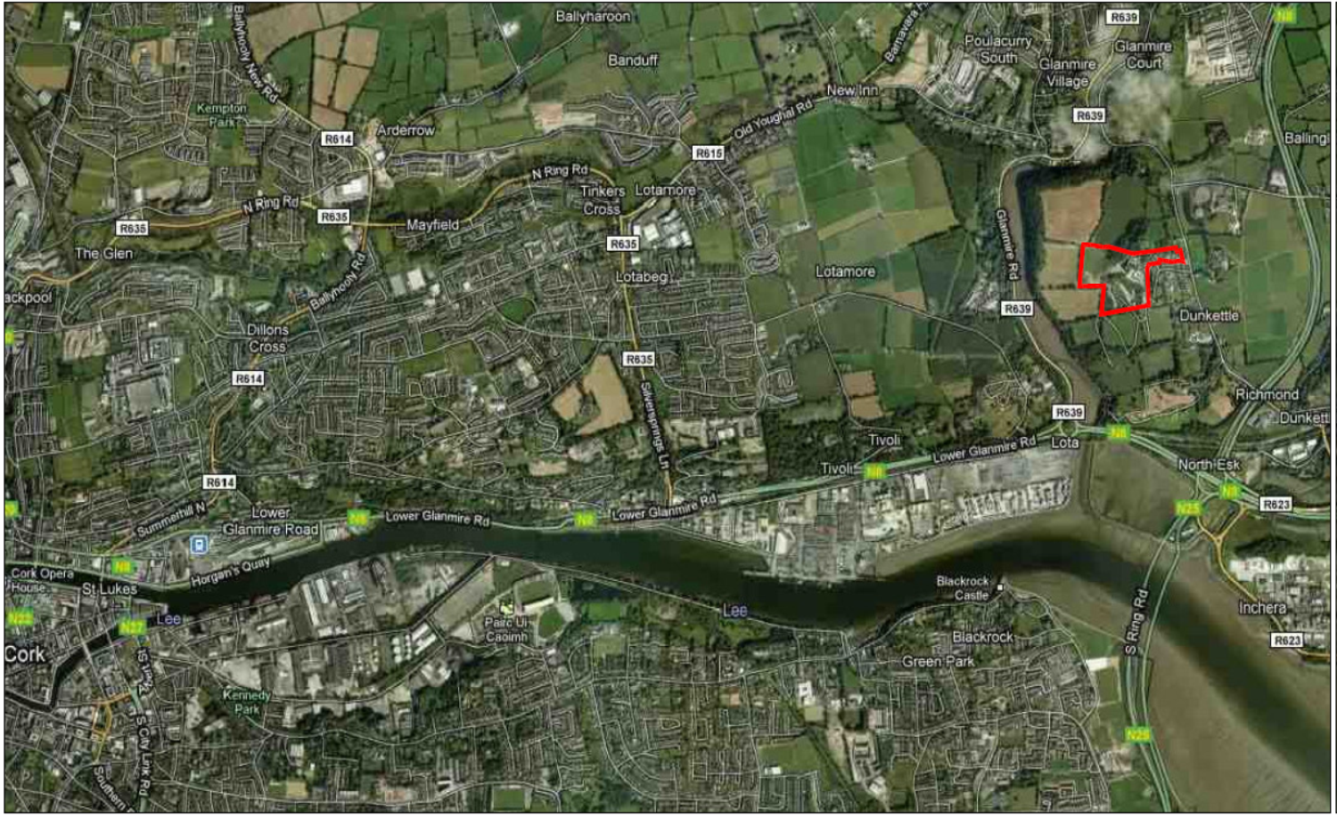

Woodville, Dunkettle, Co.Cork
Woodville Site
Jack Lynch Tunnel
Cork City
Google Image of Site

Slide 3
Woodville, Dunkettle, Co.Cork
Site Plan

Slide 4
Woodville, Dunkettle, Co.Cork
Fixed Asset Number F1 A3 – Introduction
Woodville Phase 3 refers to a 6 acre site located to the North West of the completed development phases
Road access to this site will come through the existing development
The site is fully zoned for residential development

Slide 5
Woodville, Dunkettle, Co.Cork
Fixed Asset Number F1 A3 – Site Plan
Phase 3

